Slide 1
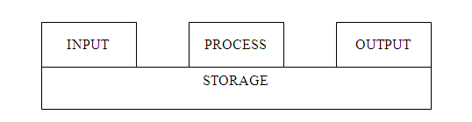
Model of information processing
IPO model with connections to storage

Slide 2
History of Computers
Computer - any programmable electronic device that can store, retrieve, and process data
In 1641, Blaise Pascal invents the first commercial calculator, a hand powered adding machine
In 1946, ENIAC, based on John Von Neuman model completes.
in 1952, the first commercially successful scientific computer is IBM 701.
A generation refers to the state of improvement in the development of a product. This term is also used in the different advancements of computer technology. With each generation, the circuitry has gotten smaller and more advanced than the previous generations before it. As a result of the miniaturization, the speed, power and memory of computers has proportionally increased. New discoveries are constantly being developed that affect the way we live, work and play. In terms of technological developments over time,
Computers have been broadly classed into five generations.

Slide 3
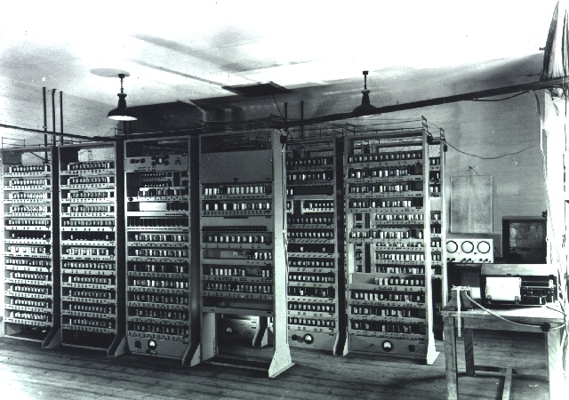
The First Generation - 1940-1956
The first computers used vacuum tubes for circuitry and magnetic drums for memory, and were often enormous, taking up entire rooms.
They were very expensive to operate and in addition to using a great deal of electricity, they generated a lot of heat, which was often the cause of malfunctions. First generation computers relied on machine language to perform operations, and they could only solve one problem at a time.
Input was based on punched cards and paper tape, and output was displayed on printouts.
The computers UNIVAC , ENIAC of the US and BESEM of the former Soviet Union are examples of first-generation computing devices

Slide 4
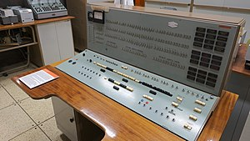
The Second Generation - 1956-1963
Transistors replaced vacuum tubes and ushered in the second generation of computers.
Computers become smaller, faster, cheaper, more energy-efficient and more reliable than their first-generation predecessors. Second-generation computers still relied on punched cards for input and printouts for output.
High-level programming languages were being developed, such as early versions of COBOL and FORTRAN.
The first computers of this generation were developed for the atomic energy industry.
The computers IBM-1070 of the US and MINSK of the former Soviet Union belonged to the second generation.
 | IDENTIFICATION DIVISION.
 | PROGRAM-ID. CONDITIONALS.
 | DATA DIVISION.
 | WORKING-STORAGE SECTION.
 | 01 NUM1 PIC 9(9).
 | 01 NUM2 PIC 9(9).
 | 01 NUM3 PIC 9(5).
 | 01 NUM4 PIC 9(6).

Slide 5
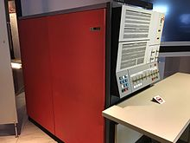
The Third Generation - 1964-1971: Integrated Circuits
The development of the integrated circuit was the hallmark of the third generation of computers. Transistors were miniaturized and placed on silicon chips, called semiconductors, which drastically increased the speed and efficiency of computers.
Users interacted with third generation computers through keyboards and monitors and interfaced with an operating system, which allowed the device to run many different applications at one time. Typical computers of the third generation are IBM 360 (United States) and EC (former Soviet Union).

Slide 6
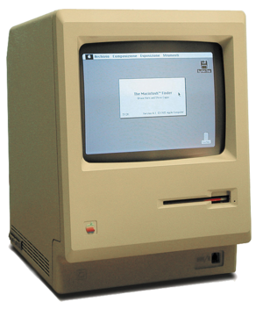
The Fourth Generation - 1971-Present: Microprocessors
The microprocessor brought the fourth generation of computers, as thousands of integrated circuits were built onto a single silicon chip. What in the first generation filled an entire room could now fit in the palm of the hand. The Intel 4004 chip, developed in 1971, located all the components of the computer - from the central processing unit and memory to input/output controls - on a single chip.
In 1981 IBM introduced its first computer for the home user, and in 1984 Apple introduced the Macintosh. Microprocessors also moved out of the realm of desktop computers and into many areas of life as more and more everyday products began to use microprocessors.
As these small computers became more powerful, they could be linked together to form networks, which eventually led to the development of the Internet. Fourth generation computers also saw the development of GUI (Graphic User Interface), the mouse and handheld devices.

Slide 7
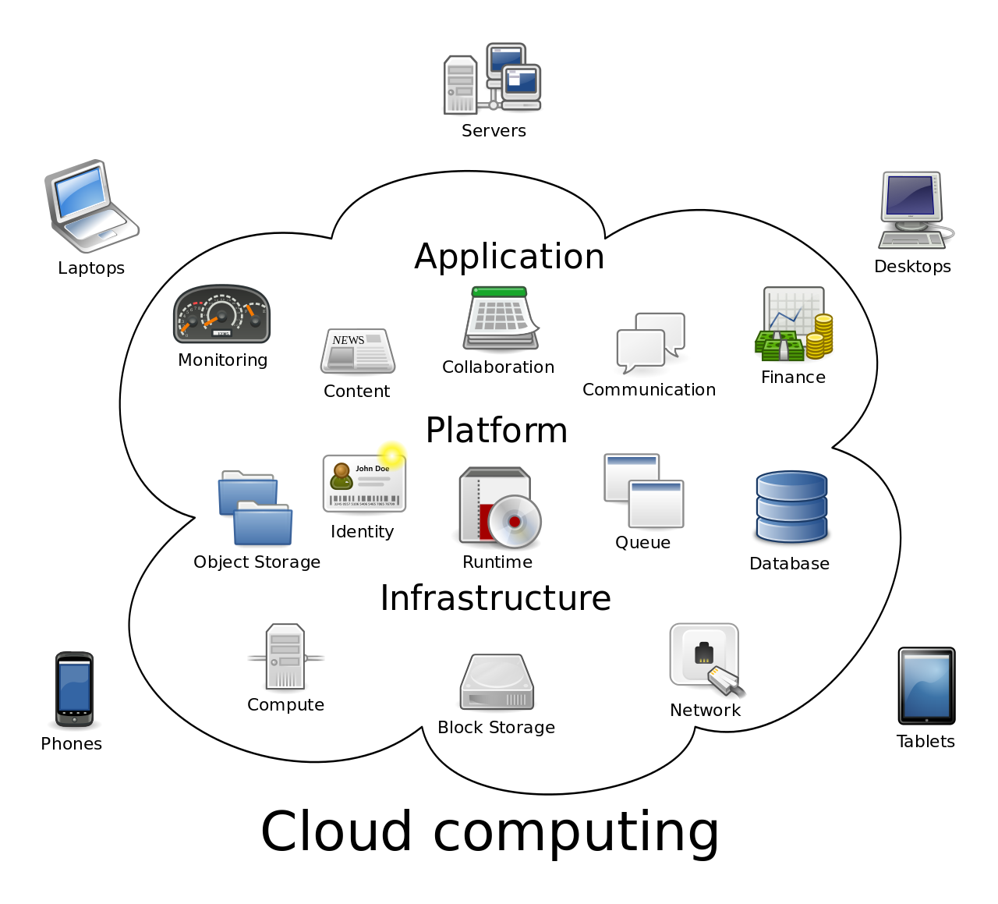
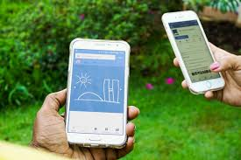
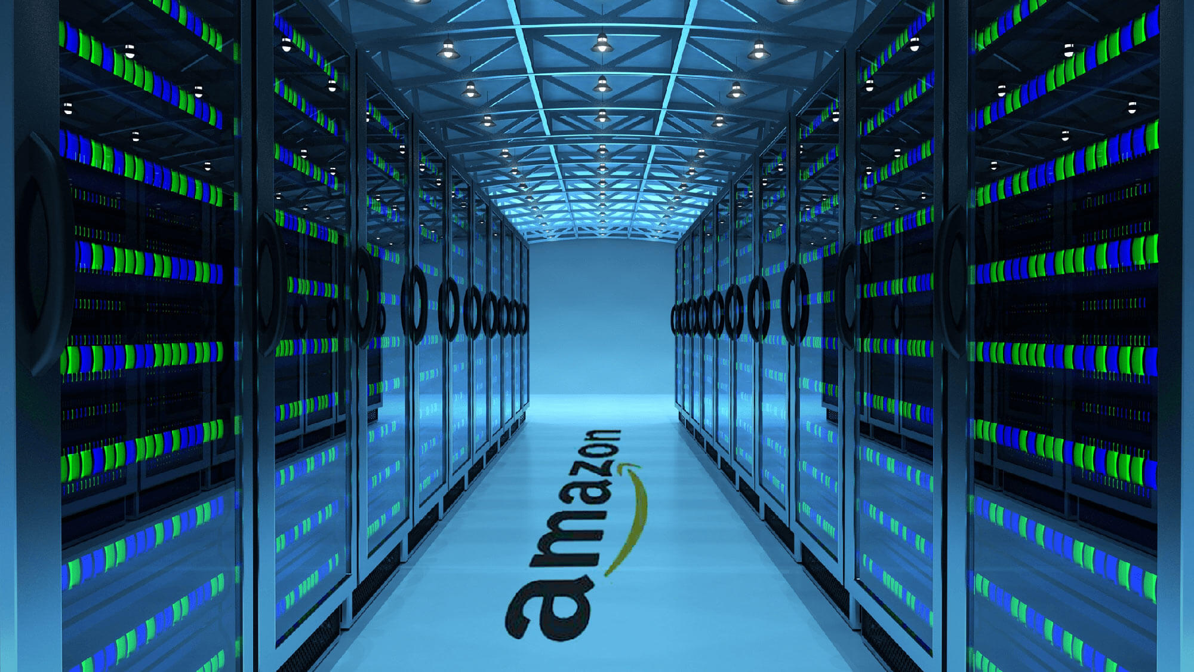
The Fifth Generation - Present and Beyond: AI, Cloud
Fifth generation computing devices, based on artificial intelligence, are still in development, though there are some applications, such as voice recognition, that are being used today.
The use of parallel processing and superconductors is helping to make artificial intelligence a reality. Quantum computation and molecular and nanotechnology will radically change the face of computers in years to come. The goal of fifth-generation computing is to develop devices that respond to natural language input and are capable of learning and self-organization.

Slide 8
(C-style) High-Level Language History Highlights
C In 1978, Brian Kernighan and Dennis Ritchie at AT&T Bell Labs (which used computers extensively for automatic phone call routing) published a book describing a new high-level language with the simple name C. The C Programming Language
C++ In 1985, Bjarne Stroustrup published a book describing a C-based language called C++, adding constructs to support a style of programming known as object-oriented programming, along with other improvements. The C++ Programming Language
Java In 1991, James Gosling and a team of engineers at Sun Microsystems (acquired by Oracle in 2010) began developing the Java language with the intent of creating a language whose executable could be ported to different processors, with the first public release in 1995.
#include <stdio.h>
//c
main()
{
printf("hello, ");
printf("world");
printf("\n");
}
//c++
class Ival_box {
public:
virtual int get_value() = 0;
virtual void prompt() = 0;
// ...
};

Slide 9
Computer Systems
Computer hardware is the physical part of a computer, including the digital circuitry, as distinguished from the computer software that executes within the hardware.
Computer software is a general term used to describe a collection of computer programs, procedures and documentation that perform some task on a computer system

Slide 10
Computer systems
Focus on big picture
Putting pieces together into a system
A system is a collection of components linked together and organized in such a way as to be recognizable as a single unit.
Optimizations
Components designed for synergy – the value of the whole is greater than the sum of its parts
Virtualization
Individual computer simulates multiple computers
All of which share the CPU and I/O
*
Notes:
The primary source for the material in this presentation (including figures and illustrations) is The Architecture of Computer Hardware, Systems Software, & Networking: An Information Technology Approach, 4th edition (plus supplementary materials) by Irv Englander (John Wiley & Sons, 2009).
‹#›

Slide 11
Computer systems
Essentially comprised of:
Central Processing Unit (CPU) Carries out individual software instructions
Primary memory (RAM) Holds instructions and data currently being used
Input and output (I/O) devices Keyboard, pointing device, monitor, secondary storage

Slide 12
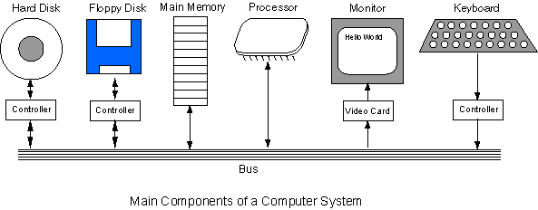
Computer System Components
All computers consist of components (processor, memory, controllers, video) connected together with a bus.

Slide 13
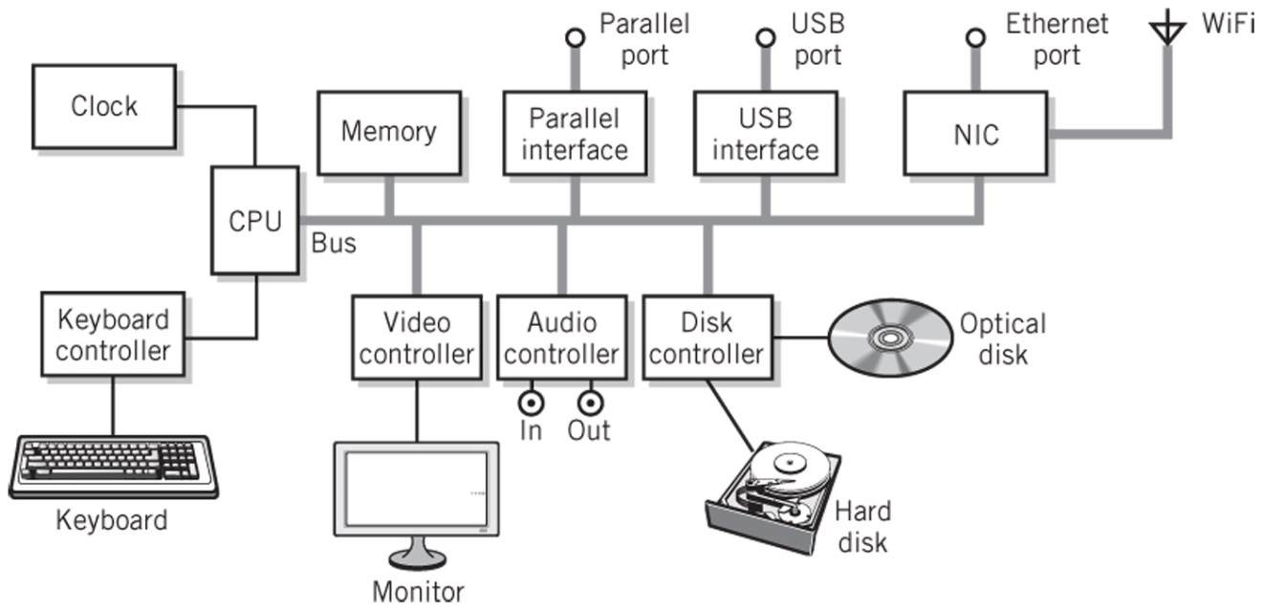
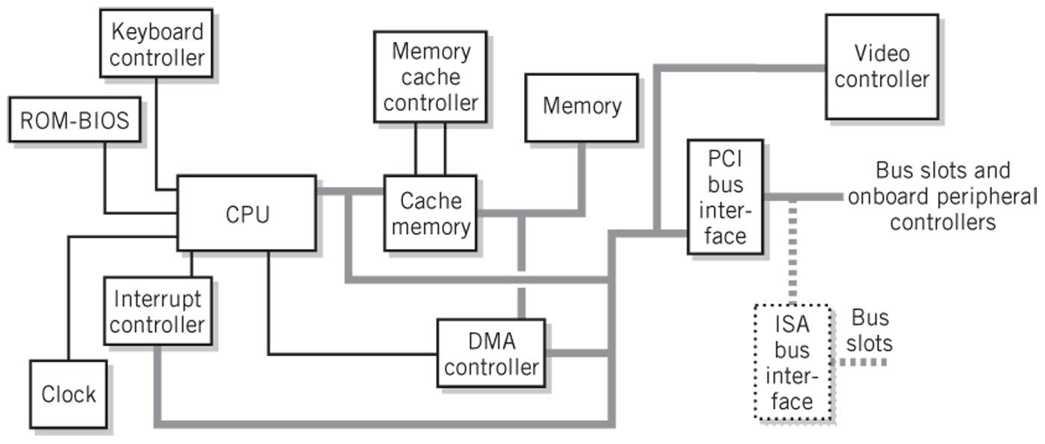
A typical PC system
*
‹#›

Slide 14
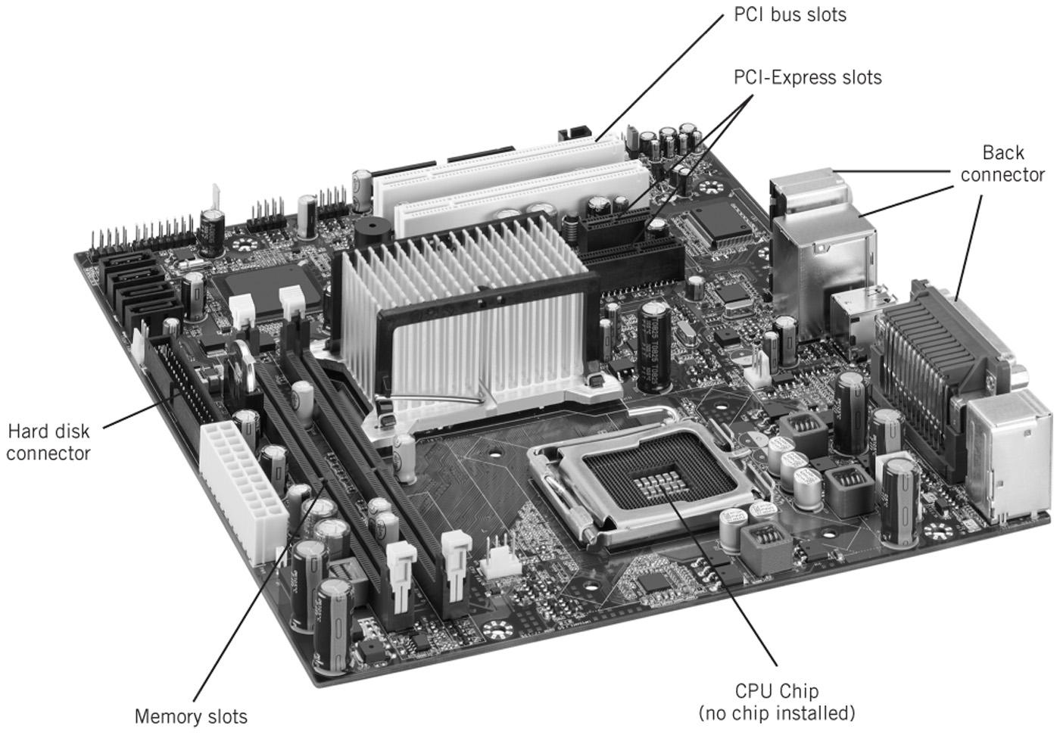
The motherboard
*
IT520 Modern Computer Systems
‹#›

Slide 15
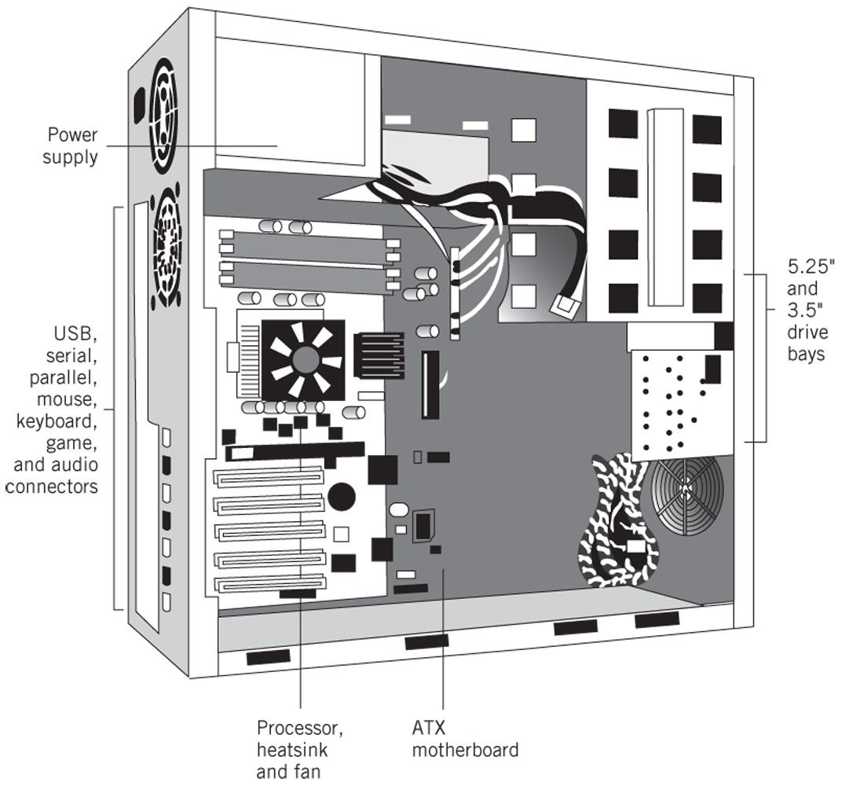
A typical desktop PC
*
IT520 Modern Computer Systems
‹#›

Slide 16
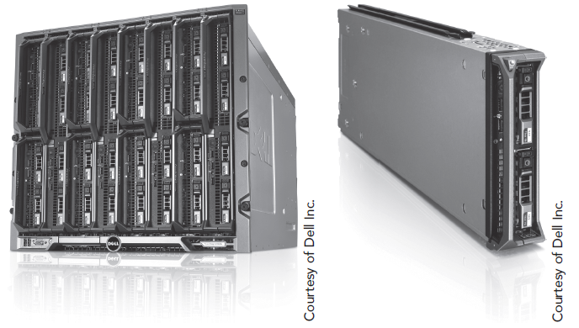
Racks/Blades
*
‹#›

Slide 17
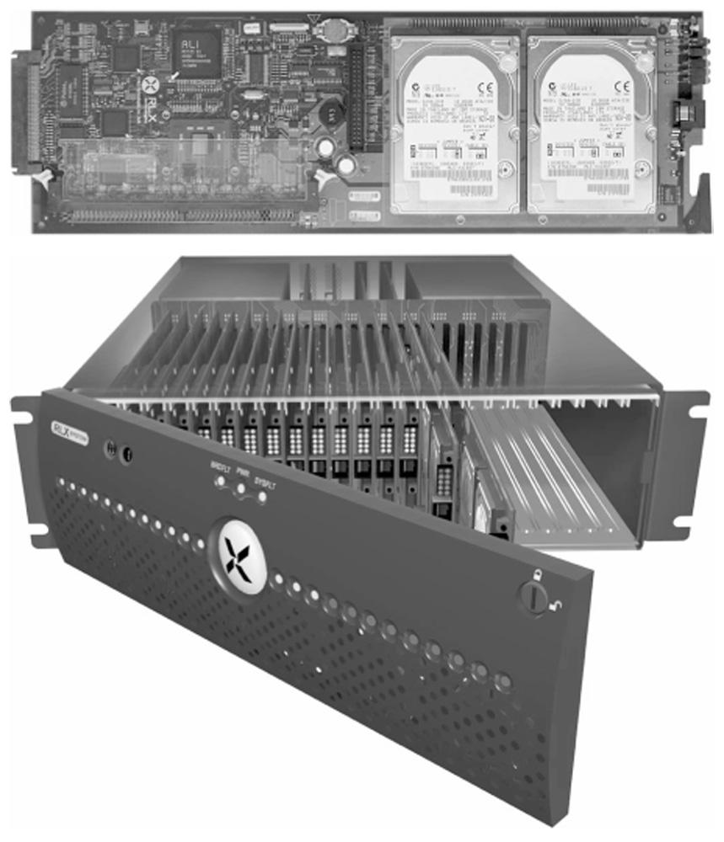
More blade and rack images
*
‹#›

Slide 18
Bus
Physically, a bus consists of many parallel wires, usually printed (in copper) on the main circuit board of the computer.
Data signals, clock signals, and control signals are sent on the bus back and forth between components.
A particular type of bus follows a carefully written standard that describes the signals that are carried on the wires and what the signals mean.
The PCI standard (for example) describes the PCI bus used on most current PCs.

Slide 19
Processor Operations
The processor continuously executes the machine cycle, executing machine instructions one by one.
Most instructions are for an arithmetical, a logical, or a control operation.
A machine operation often involves access to main storage or involves an i/o controller. If so, the machine operation puts data and control signals on the bus, and (may) wait for data and control signals to return.
Some machine operations take place entirely inside the processor (the bus is not involved). These operations are very fast.

Slide 20
Input/output Controllers
The way in which devices connected to a bus cooperate is another part of a bus standard. Input/output controllers receive input and output requests from the central processor, and then send device-specific control signals to the device they control. They also manage the data flow to and from the device. This frees the central processor from involvement with the details of controlling each device. I/O controllers are needed only for those I/O devices that are part of the system.

Slide 21
I/O controllers (cont.)
Often the I/O controllers are part of the electronics on the main circuit board (the mother board) of the computer. Sometimes an uncommon device requires its own controller which must be plugged into a connector (an expansion slot) on the mother board. I/O controllers are sometimes called device controllers. The software that directly interacts with a device controller is called a device driver. When you install a new device on your computer (say, a new graphics board) you must also install a device driver for it.

Slide 22
Main Memory
In practice, data and instructions are often placed in different sections of memory, but this is a matter of software organization, not a hardware requirement.
Also, most computers have special sections of memory that permanently hold programs (firmware stored in ROM), and other sections that are permanently used for special purposes. Main memory (also called main storage, or just memory) holds the bit patterns of machine instructions and the bit patterns of data. Memory chips and the electronics that controls them are concerned only with saving bit patterns and returning them when requested. No distinction is made between bit patterns that are intended as instructions and bit patterns that are intended as data.

Slide 23
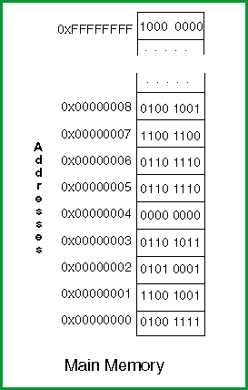
Addresses
Each byte of main storage has an address. Most modern processors use 32-bit (2³²) or 64-bit(2⁶⁴) addresses Think of main storage as if it were an array.
byte[0x00000000 ... 0xFFFFFFFF] mainStorage;
A main storage address is an index into memory. A 32-bit address is the address of a single byte. Thirty-two wires of the bus contain an address (there are many more bus wires for timing and control).

Slide 24
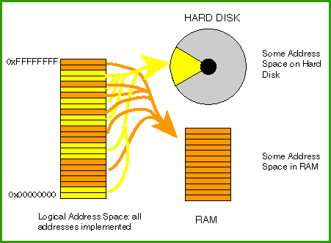
Virtual Memory
A 32-bit address space can contain 4 gigabytes of memory. Ideally, all of these memory locations would be implemented using memory chips (usually called RAM). On modern computers, the full address space is present no matter how much RAM has been installed. This is done by keeping some parts of the full address space on disk and some parts in RAM. This method of providing the full address space by using a combination of RAM memory and the hard disk is called virtual memory. The word virtual means "appearing to exist, but not really there."

Slide 25
Cache Memory
Disk access is slow compared to RAM access. Computer systems also have cache memory. Cache memory is very fast RAM that is inside (or close to) the processor. It duplicates sections of main storage that are heavily used by the currently running programs. The processor does not have to use the system bus to get or store data in cache memory. Access to cache memory is much faster than to normal main memory. Like virtual memory, cache memory is invisible to most programs. It is an electronic detail below the level of abstraction provided by assembly language. Hardware keeps cache up to date and in synch with main storage. Your programs are unaware that there is cache memory and virtual memory. They just see "main memory". Application programs don't contain instructions that say "store this in cache memory", or say "get this from virtual memory". They only refer to the contents of main memory at a particular address. The hardware makes sure that the program gets or stores the correct byte, no matter where it really is.

Slide 26
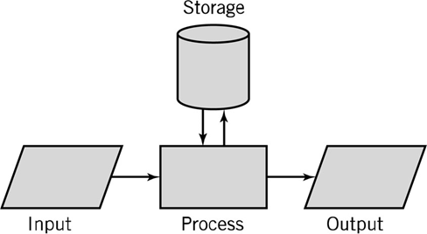
IPO Model
Work done by computer systems is characterized by Input-Process-Output (IPO) Model:
•Input: keyboard, mouse, touchscreen, scanner, microphone
•Processing: CPU, coprocessors
•Output: monitor, printer, speakers
•Storage: RAM, hard drive, optical media, flash drives

Slide 27
Von Neumann Machine
The von Neumann architecture—also known as the von Neumann model or Princeton architecture—is a computer architecture based on a 1945 description by the mathematician and physicist John von Neumann
The bytes that make up the machine instructions of a program are stored in main memory and fetched into the processor as needed.
Data is also kept in main memory. Keeping both data and instructions in main memory is one of the characteristics of a von Neumann machine, the name for the basic design of most modern computers.

Slide 28
Von Neumann Components
A processing unit that contains an arithmetic logic unit and processor registers
A control unit that contains an instruction register and program counter
Memory that stores data and instructions
External mass storage
Input and output mechanisms

Slide 29
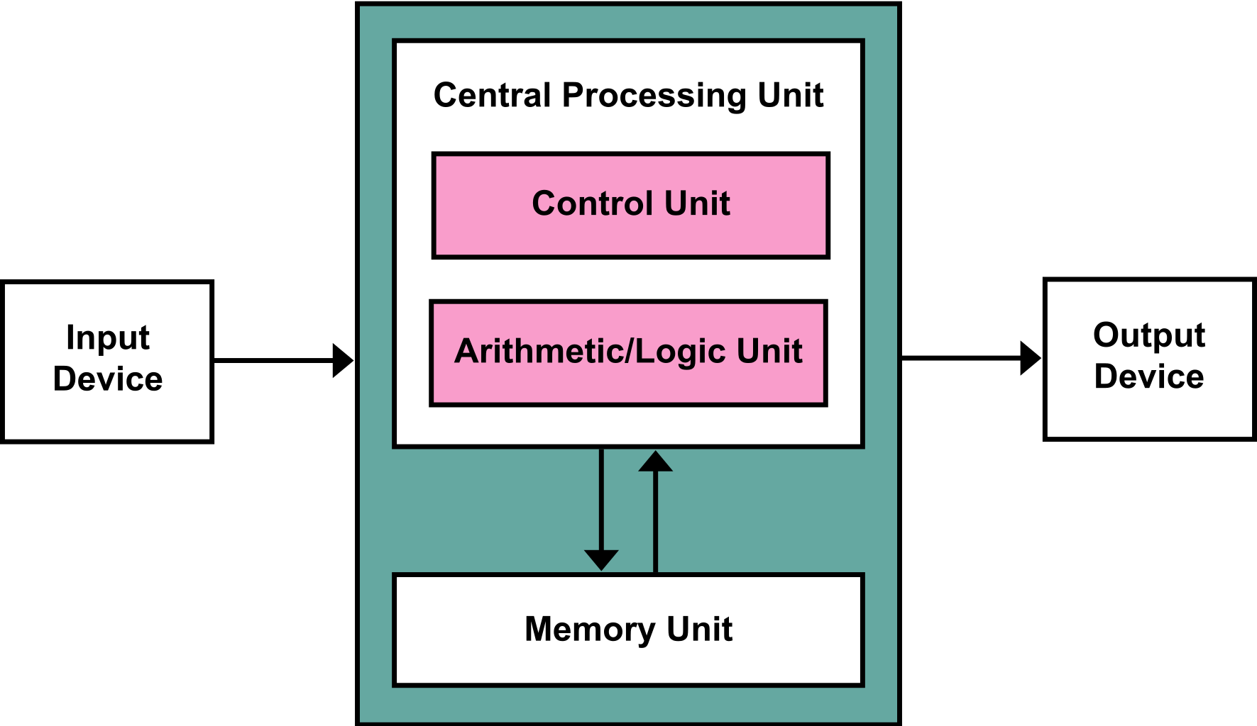
Von Neumann Architecture

Slide 30
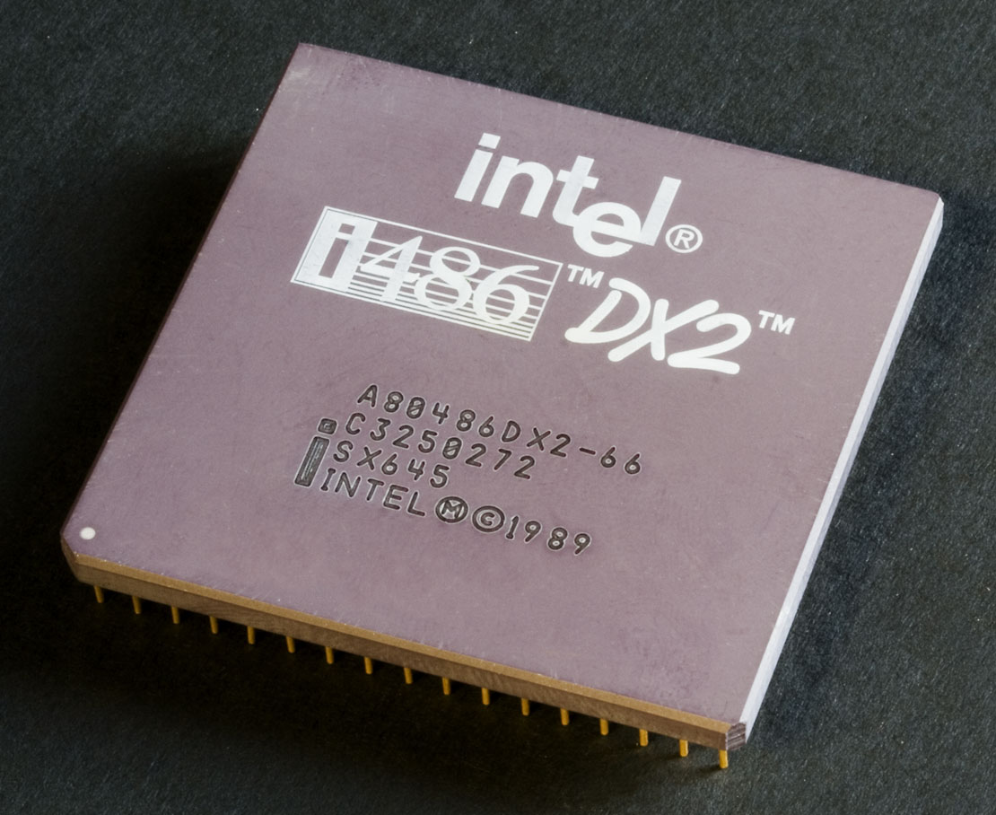
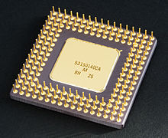
Central processing unit
A central processing unit (CPU), also called a central processor or main processor, is the electronic circuitry within a computer that carries out the instructions of a computer program by performing the basic arithmetic, logic, controlling, and input/output (I/O) operations specified by the instructions.
Most modern CPUs are microprocessors, meaning they are contained on a single integrated circuit (IC) chip.

Slide 31
Registers
a processor register is a quickly accessible location available to a computer's central processing unit (CPU).
load data from a larger memory into registers where it is used for arithmetic operations and is manipulated or tested by machine instructions. Manipulated data is then often stored back to main memory, either by the same instruction or by a subsequent one.
Registers are normally measured by the number of bits they can hold, for example, an "8-bit register", "32-bit register" or a "64-bit register"

Slide 32
Control Unit
The control unit (CU) is a component of a computer's central processing unit (CPU) that directs the operation of the processor. It tells the computer's memory, arithmetic and logic unit and input and output devices how to respond to the instructions that have been sent to the processor.
Contains:
Instruction Register (IR) part of a CPU's control unit that holds the instruction currently being executed or decoded
Program Counter (PC) is a processor register that indicates where a computer is in its program sequence

Slide 33
Arithmetic Logic Unit (ALU)
An arithmetic logic unit (ALU) is a combinational digital electronic circuit that performs arithmetic and bitwise operations on integer binary numbers.
This is in contrast to a floating-point unit (FPU), which operates on floating point numbers.
An ALU is a fundamental building block of many types of computing circuits, including the central processing unit (CPU) of computers, FPUs, and graphics processing units (GPUs). A single CPU, FPU or GPU may contain multiple ALUs.

Slide 34
ALU Operations
The inputs to an ALU are the data to be operated on, called operands, and a code indicating the operation to be performed; the ALU's output is the result of the performed operation.
In many designs, the ALU also has status inputs or outputs, or both, which convey information about a previous operation or the current operation, respectively, between the ALU and external status registers.

Slide 35
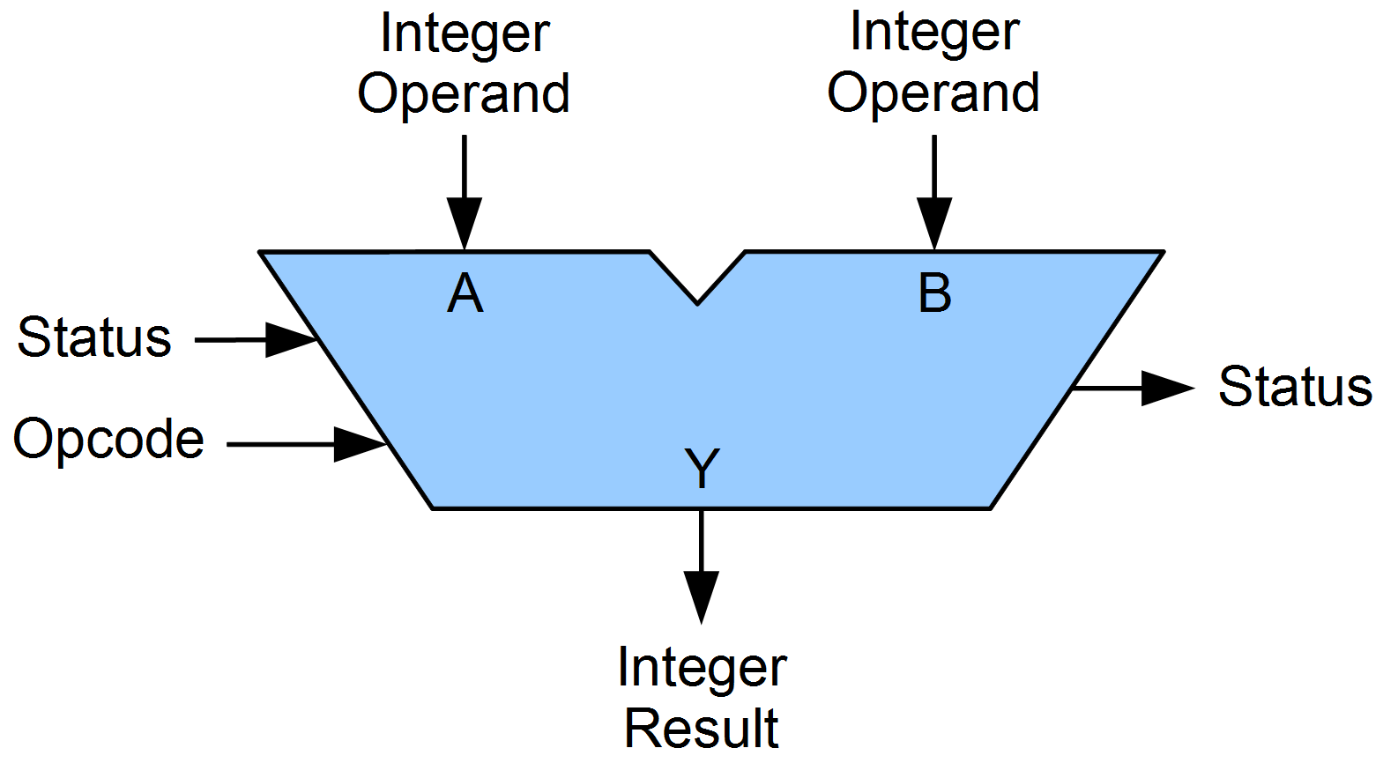
ALU Operations (Cont.)

Slide 36
Types of ALU Operations
Arithmetic
Add, Subtract, negate (two's complement)
Bitwise Logical
And, Or, XOR, invert (one's complement)
Bit shift
Left, Right

